Slide 1
Nakuja Internship 2026
Solid Propulsion Team
Weekly report #5
Presented by: Collins Kinyua
July 17, 2026

Slide 2
Tasks completed this week
Cooking of grains for one grain static test (addition of surfactant & suppressant)
Pyrogenic ignitor cooking and testing
Purchasing of items i.e. Stainless steel casing, crafting paper
Design and fabrication of new igniter circuit
One grain static fire test

Slide 3
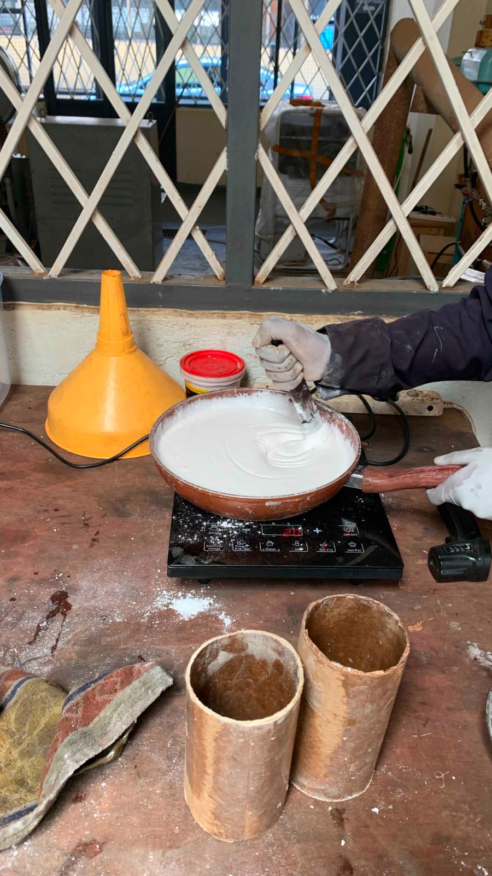
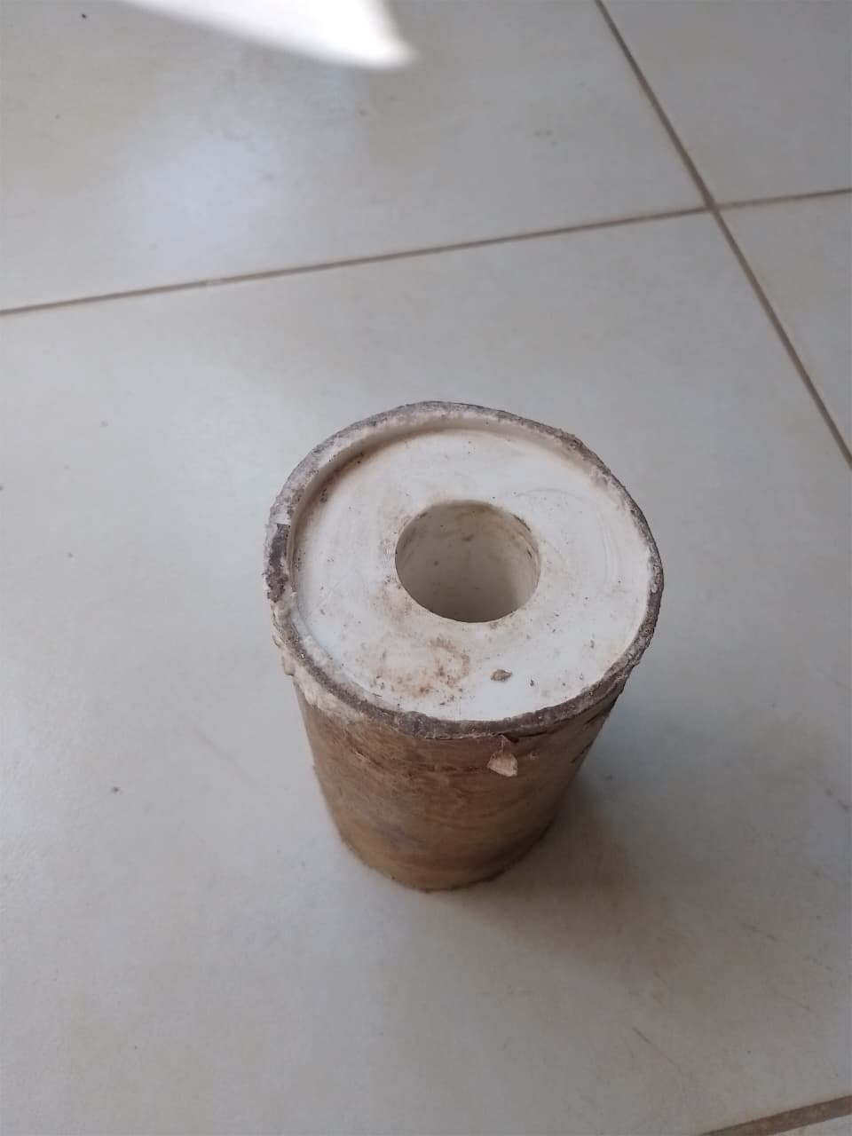
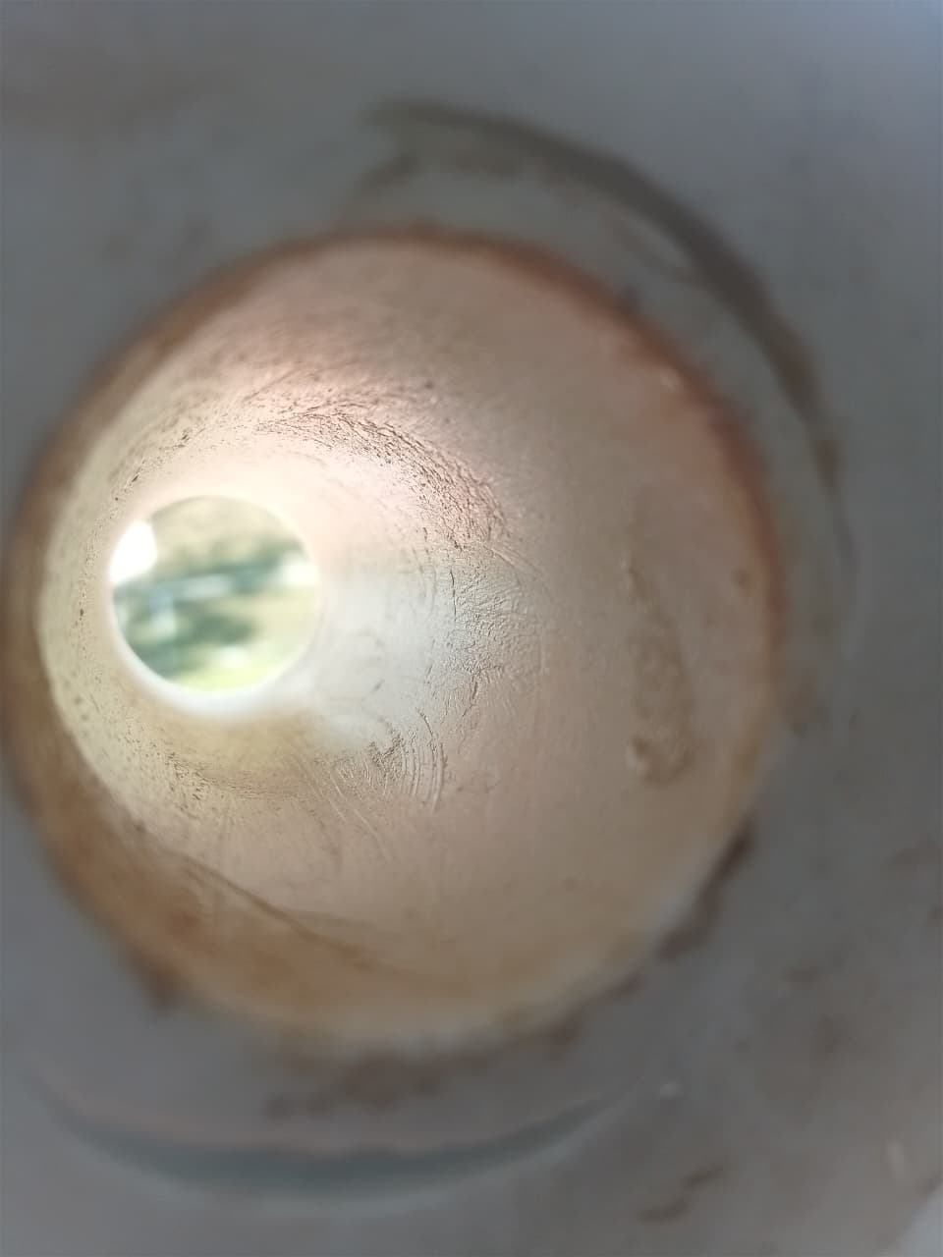
1. Cooking of grain for static test – Addition of surfactant
Purpose: This grain contained ~1.8% of Sodium Laureth Sulphate (SLES) which is used as a surfactant i.e. it lowers the surface tension between the fuel (Sorbitol) and oxidizer (KNO3) which improved castability and removed air bubbles.
Major breakthrough: We were able to mitigate voids and air bubbles within the grains
Grain during cooking: Grain after curing: Grain core:

Slide 4
2. Cooking of pyrogenic igniter and testing
Purpose: This ignitor contained a new cooking method in an attempt to increase the burn rate of the ignitor by using black powder in the middle section of the ignitor and as our main pyrogen to generate required temperature and pressure while the KNSB is used as the binder.

Slide 5
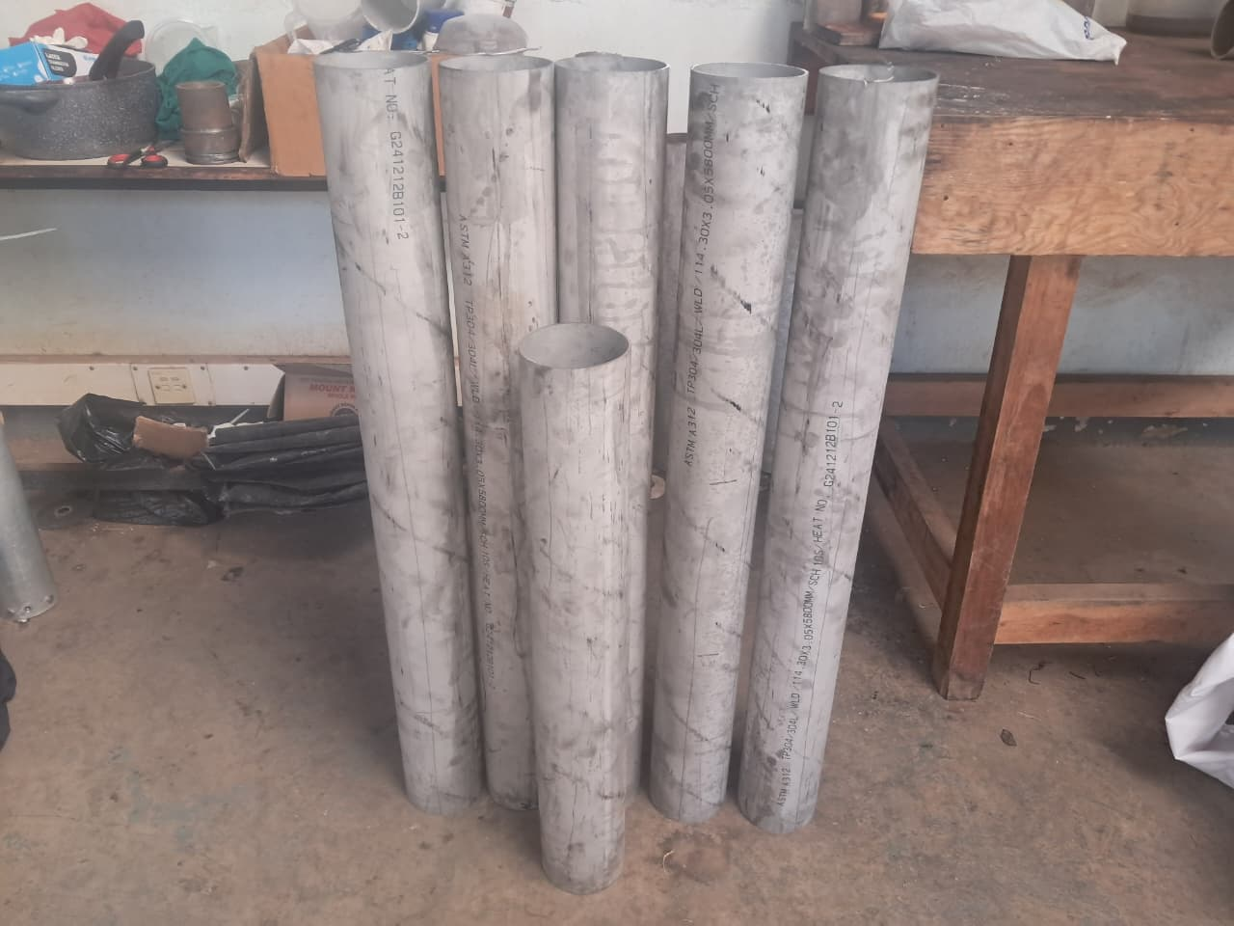
3. Purchasing of items i.e. Stainless steel casing & craft paper
Purpose: This was done in preparation for the five grain test, the Stainless Steel G 304 schedule 10 round tube will be used as the casing while the craft paper will be used as ablative liner.

Slide 6
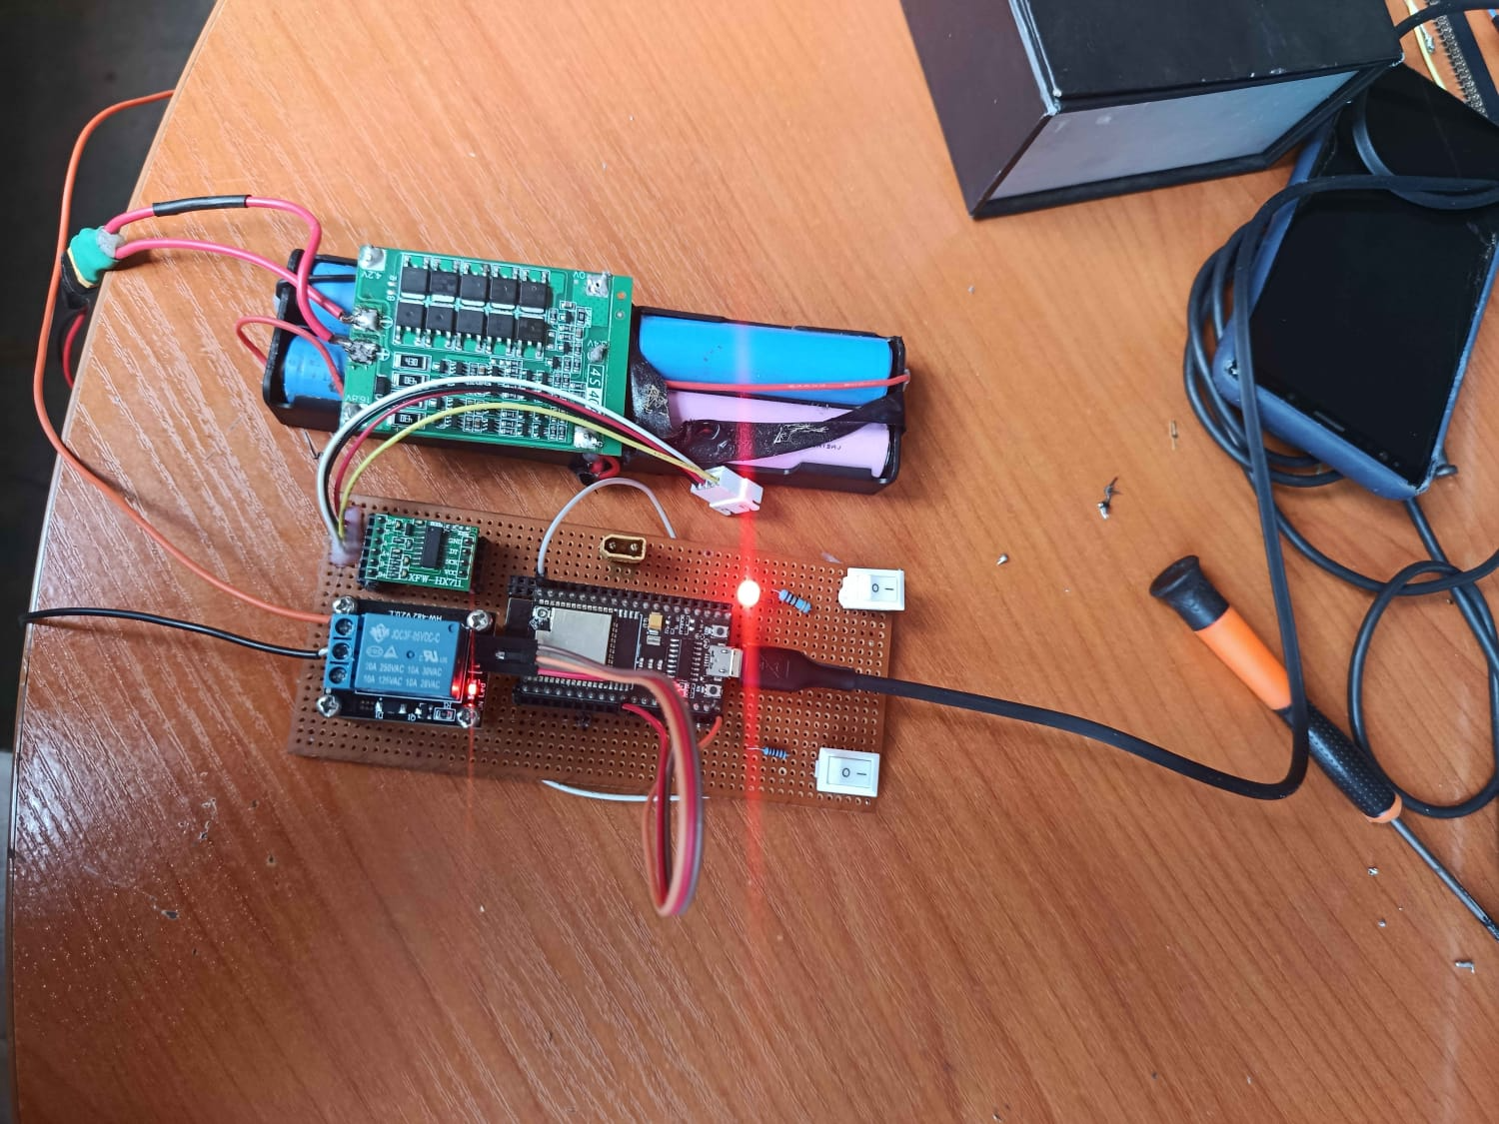
4. Design and fabrication of new trigger circuit
Problem statement: During last weeks’ (10/07) dry run and static test, the igniter circuit proved to be unreliable as we experienced various faults i.e. Miss-fire, incorrect data from load cell, short circuit that destroyed a mosfet.
Due to this challenges, the ignition circuit sub-team decided to fabricate a new pcb which to improve on reliability.
Result:

Slide 7
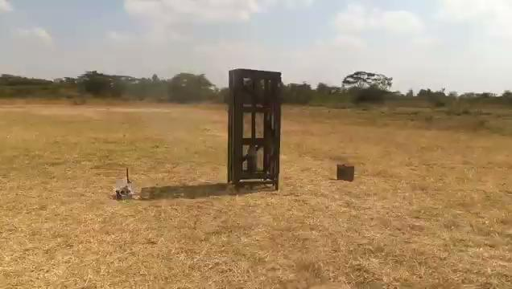
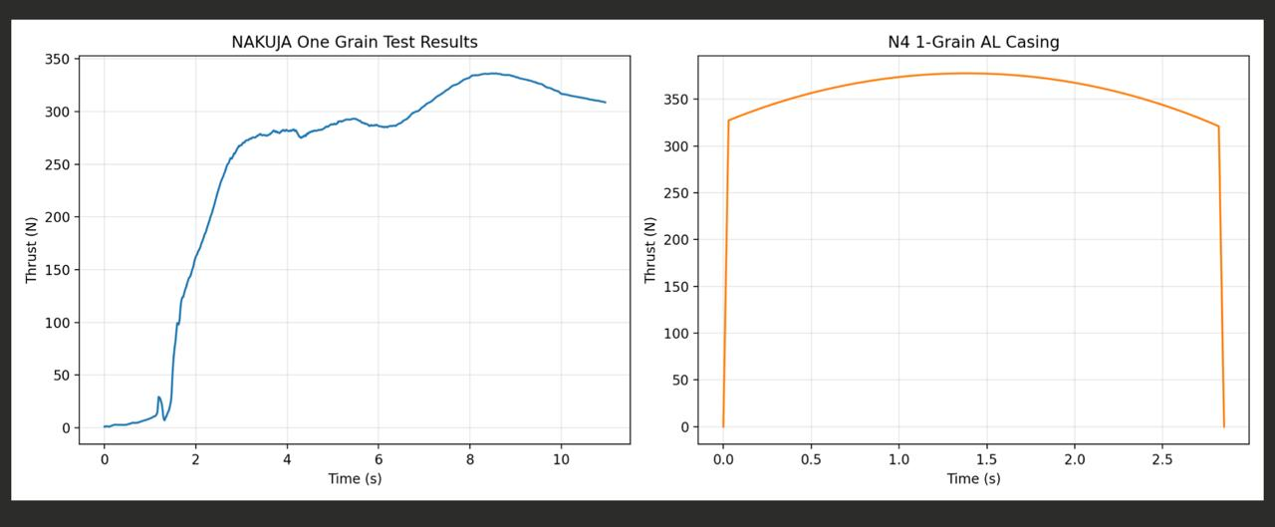
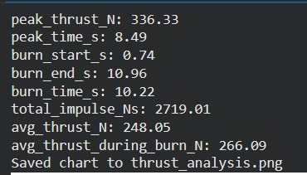
5. One grain static test #1
Purpose: This test was done as a control variable using the current grain preparation methods and the data will be compared against subsequent tests.
Video footage: Thrust curve comparison:

Slide 8
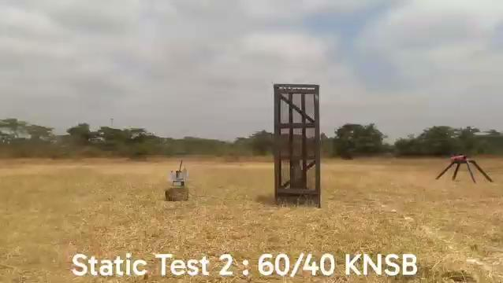
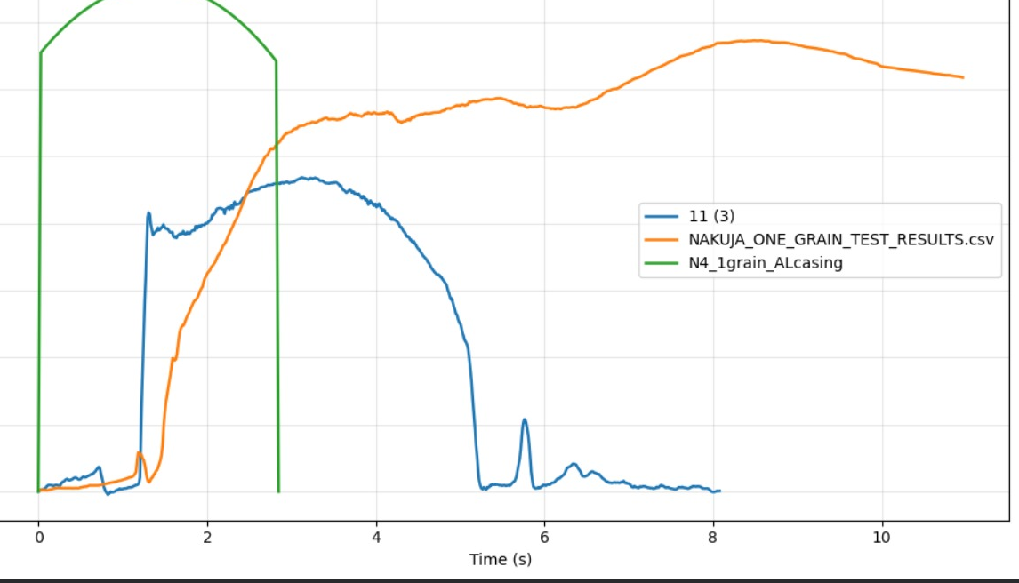
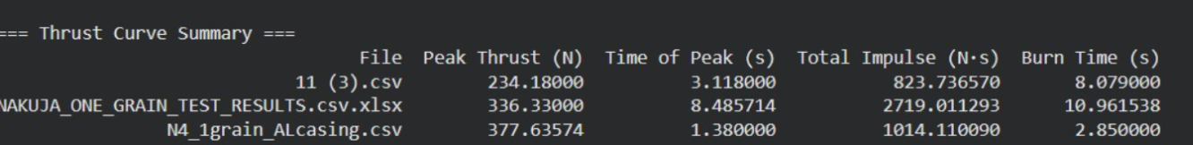
6. One grain test #2
Purpose: This test was done with a propellant grain with an altered Oxidiser to Fuel ratio of 60:40 as opposed to the standard 65:35, which means that the propellant is fuel rich which should correspond to a lower thrust output. This was done in an attempt to lower the thrust output.
Video footage: Thrust curve:

Slide 9
Next week's tasks
Ignitor preparation and testing
Cooking of grains for testing
One grain static test
Old grains disposal
Liner thickness testing (Burn test)
Motor assembly for one grain test
3D print ignition circuit casing

Slide 10
Challenges experienced
Unavailability of power led to delays in 3D printing.
Unavailability of project car led us to use a wheelbarrow to transport the test stand which was tedious.
Supervisors’ note:
Visit Solid Propulsion github projects @ https://github.com/orgs/nakujaproject/projects/26 to review the tasks done.

Slide 11
Potential concerns
Due to a higher expected thrust output value for the five grain test, our load cell cannot record the expected peak thrust thus a new load cell is required.
An increase in Solid Rocket Motor diameter and requires redesign of the body tube and flight computer avionics bay to compensate for this change.

Slide 12

Thank you for your attention!

